Slide 1
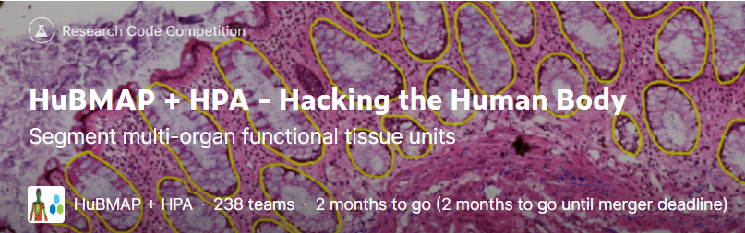
HuBMAP + HPA – Hacking the Human Body
Progress Meeting -Group Kaggle
Contributor: Qiaochu Zhao, Botao Jiang, Bei Jin, Juntuo Wang, Sitang Gong, Suqi Zhang, Lin
https://www.kaggle.com/competitions/hubmap-organ-segmentation

Slide 2
01
Larger Size Image
02
More Folds
03
Stain Normalization
CONTENTS
04
Ensemble Learning
05
TRANSFER LEARNING
06
SEMI-SUPERVISED LEARNING

Slide 3
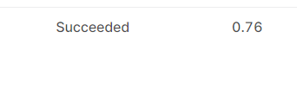
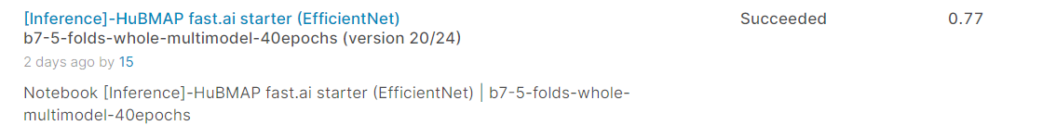


01
Larger Size Image + multimodal
Botao Jiang
768 + 5folds+ b7 （Before last presentation)
768 + 5folds+ b7 + multimodal
896 + 5folds + b7 + multimodal
1024 + 5folds + b7 + multimodal

Slide 4

02
More Folds + multimodal
Bei Jin
768 + 5folds + b7 + multimodal
768 + 7folds + b7 + multimodal

Slide 5
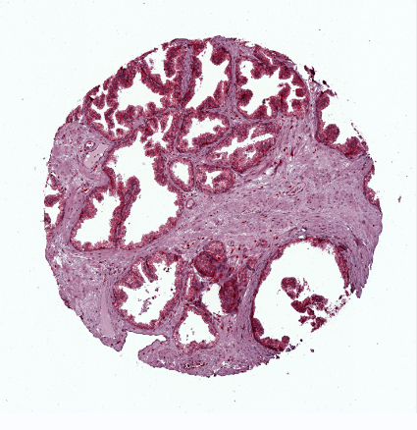
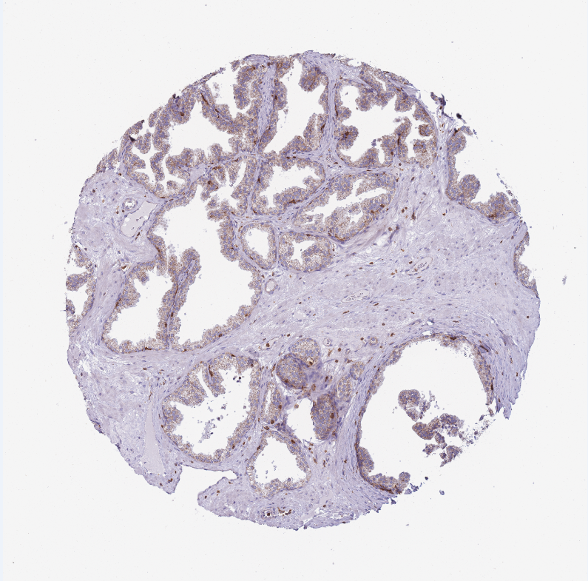
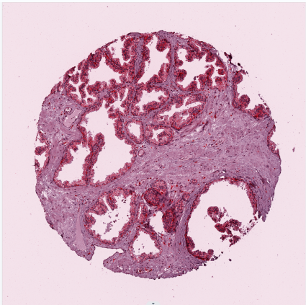
03
Stain Normalization + multimodal
Sitang Gong, Juntuo Wang
All train on Unext50 + 768 + 5folds + multimodal
Torchstain: 0.71
Original: 0.71
Staintools: 0.73

Slide 6
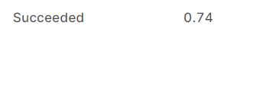
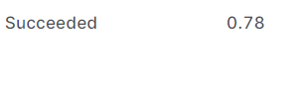
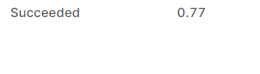
04
Ensemble Learning
Juntuo Wang, Suqi Zhang
Unext101 + 1024 + 5folds + multimodal
b7 + 1024 + 5folds + multimodal

Slide 7
05
Transfer learning
Qiaochu Zhao, Lin
TRANSFER LEARNING
We first trained on Kidney's dataset to get the pre-training weights, and then trained on a multi-organ dataset.
The original pre-training weights of EfficientNet-b7 are based on a multi-category task with 23 categories, which I guess is about semantic segmentation of categories such as street view, pedestrian. The features of the categories of this type of task are not similar to those of the medical domain.
Therefore, we conjecture that the model was pre-trained on the kidney dataset and could learn more about the weights of human tissue features, which is a direction to improve the score.

Slide 8
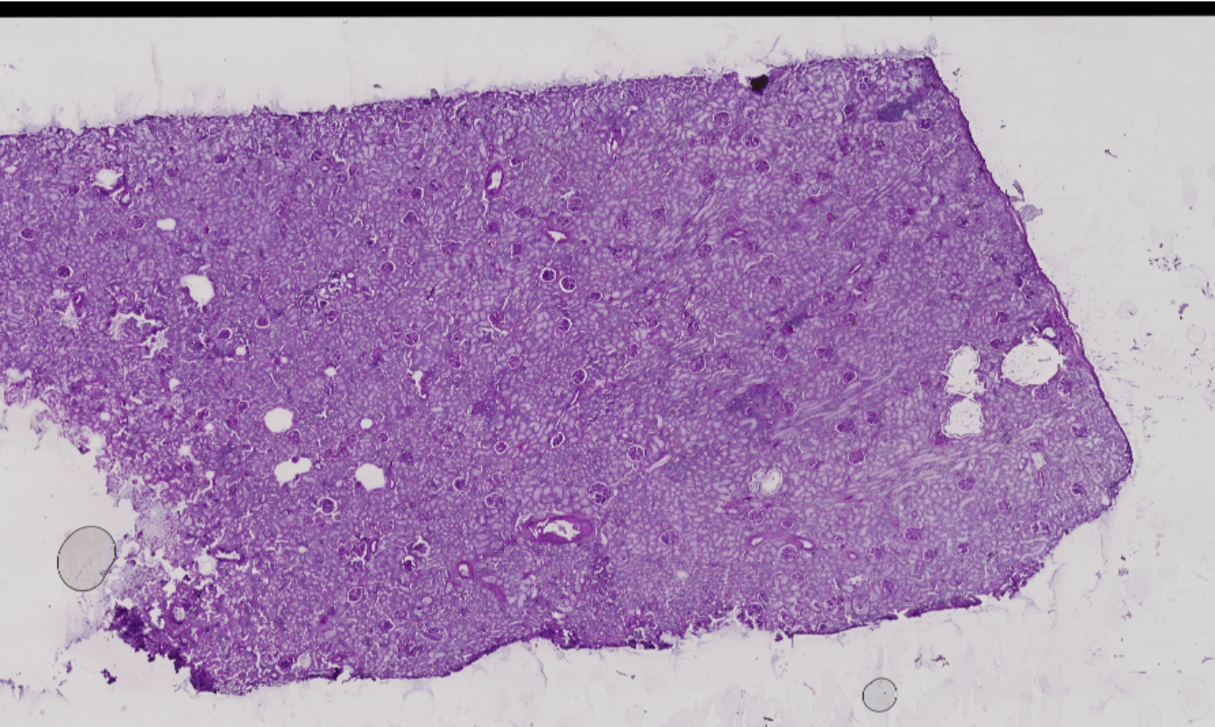
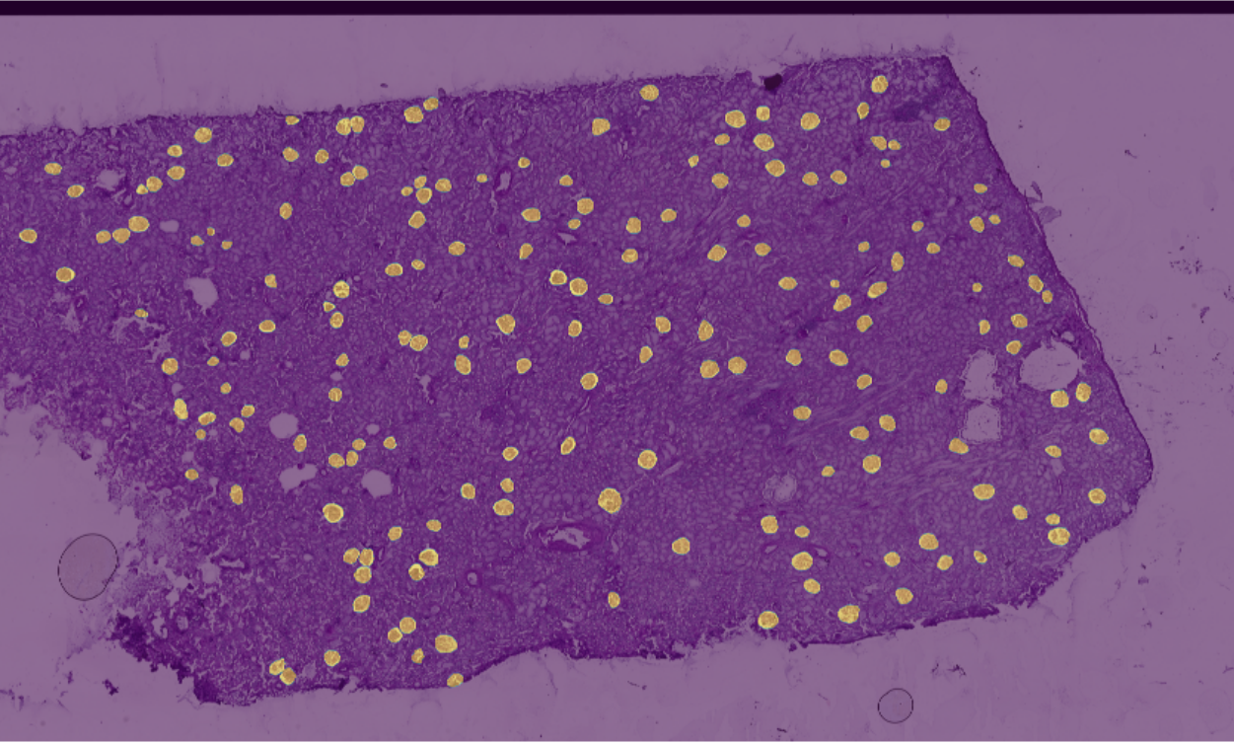
05
Transfer learning
TRANSFER LEARNING
Overview of kidney dataset:
There are 15 digital pathology images in the training dataset, each digital and force map is about 30,000x30,000 in size.
Image
Image merge with mask
We divide the large size image into 3000x3000 tiles and only keep the tiles that has label information. Finally, 760 training images are obtained.

Slide 9
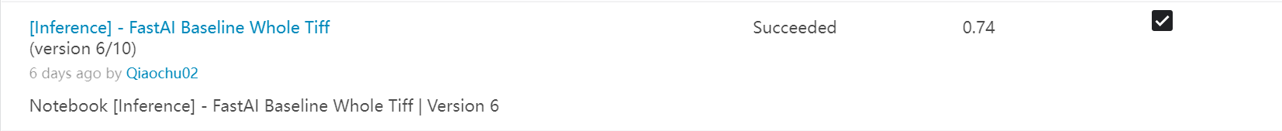

05
Transfer learning
TRANSFER LEARNING
Testing result of transfer learning approach:
The speed of fitting during training is very fast, usually within 20 epochs
However the score being lower
Actually, we are a few confuesd by this result. And we will use this method for more tests, such as adjusting the number of folds and image size.

Slide 10
06
SEMI-SUPERVISED LEARNING
Qiaochu Zhao, Lin
SEMI-SUPERVISED LEARNING
We have collected some unlabeled dataset from internet. Expanding the training dataset by semi-supervised learning is worth to try.
Semi-supervised learning is not as easy to implement on semantic segmentation tasks as on other tasks. Because we judge the performance of the model based on dice score which need corresponding mask.

Slide 11
06
SEMI-SUPERVISED LEARNING
SEMI-SUPERVISED LEARNING
Our current strategy to utilize unlabeled dataset and achieve semi-supervised learning:
Use the current best-performing model as the teacher model.
Clustering of unlabled datasets, C1, C2, C3 ... Cn.
Using teacher model to predict clusters and got corresponding mask: C1 mask, C2 mask, C3 mask ... Cn mask.
Using teacher model to train new expanded dataset, new expanded dataset can be:
C1+original dataset
C2+original dataset
...
Cn+original dataset
Get new models by training new expanded datasets.
Scoring new models using the kaggle website. If the score is improved, add the corresponding cluster dataset into original dataset.
The above method is our idea plan, we haven't started testing yet.

Slide 12
FUTURE IMPROVEMENT
New embedding
Test transfer learning by adjusting the number of folds and image size.
Try semi-supervised learning.

Slide 13
Thanks : )

